Slide 1
Using an Online Interactive Textbook for Content Delivery in a large on-campus Mathematics for Economists course
Ralf Becker The University of Manchester
Some of the work leading to this has been supported by the Royal Economic Society, COVID support funds.

Slide 2
Interactive online textbooks …
are a possible content delivery mechanism
deliver useful learning support for students
can create free lecture time that can be used in great ways
are a lot of work to create
require a reliable technical platform

Slide 3
Today’s talk
Where did I use it?
What are they?
Why did I use it?
How did students use them?
What did students think?

Slide 4
Setting the Scene
Compulsory Mathematics for Economists (up to constrained, multivariate optimisation – Lagrange)
Students from a variety of programmes (Specialist economics, but also economics and business, economics and other social sciences, economics and history, etc)

Slide 5
Pre - Pandemic
700+ students
600 first years and 100 2nd years
Piazza Discussion Board (very busy)
Contact Time
Lectures in large Lecture Theatres (the largest was too small in weeks 1 and 2) and ok after that
8 weeks of tutorials (up to 40 students)
Content Delivery
Material through Lecture Slides and Textbook

Slide 6
Pandemic (2020/21)
900+ students
800 first years and 150 2nd years
Piazza Discussion Board (very busy)
Contact Time
Weekly Review and Q&A Sessions
5 weeks of online tutorials (up to 40 students)
Content Delivery
Material through Online Interactive Textbook (traditional textbook remains available)

Slide 7
“Post” – Pandemic (2021/22)
900+ students
800 first years and 150 2nd years
Piazza Discussion Board (very busy)
Contact Time
Weekly Review and Q&A Sessions (live but online)
5 weeks of on-campus tutorials (up to 40 students)
Content Delivery
Material through Online Interactive Textbook (traditional textbook remains available)

Slide 8
Advanced Mathematics
2019/20
A typical week
Lecture
A tutorial (on-campus)
A quiz
online discussion board

Slide 9
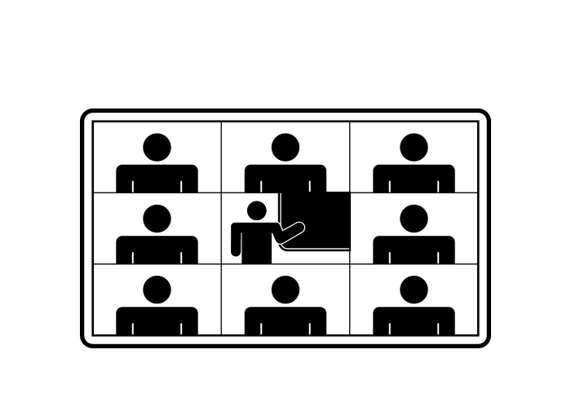
Advanced Mathematics
2020/21
A typical week
A content lesson
A tutorial (online)
A quiz
Review and Q&A (online)
online discussion board

Slide 10
Advanced Mathematics
2021/22
A typical week
A content lesson
A tutorial (on-campus)
A quiz
Review and Q&A (online)
online discussion board

Slide 11
Advanced Mathematics
2022/23
A typical week
Review and Q&A (1h online, 1h on-campus)
A content lesson
A tutorial (on-campus)
A quiz
online discussion board

Slide 12
What is an interactive textbook
Text, Video and quizzes in one place
Integrated with VLE/LMS (Student enrolment, grade information)
0110100101000101011101000111000110

Slide 13
What is an interactive textbook/lesson?

Slide 19
The attempt and grade information for every student is available and can be synched to VLE.

Slide 20
You can ask for algebraic answers (Syntax like Excel formulae)
Can randomise algebra and hence allow multiple practice attempts
Picks up your browser’s language

Slide 21
What platform offers this service?
Online textbook option, Test engine, £££
Test engine, £ Example:
Refresher Mathematics for Economics
Test engine, £ Example:
Open University
For mathematically less demanding purposes other platforms exist: e.g. Xerte

Slide 22
Why did I use it?
Mash-up of text and videos
Testing and reinforcing the students’ learning process through the build-in questions
The biggest advantage of using interactive textbooks is what you can do in the lecture

Slide 23
How did students use it?

Slide 24
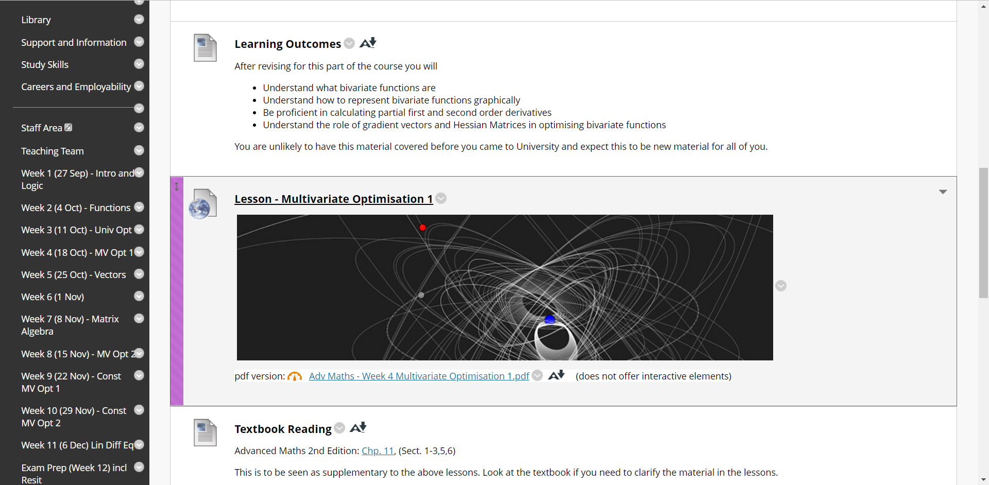
Usage

Slide 25
2020/21
2021/22

Slide 26
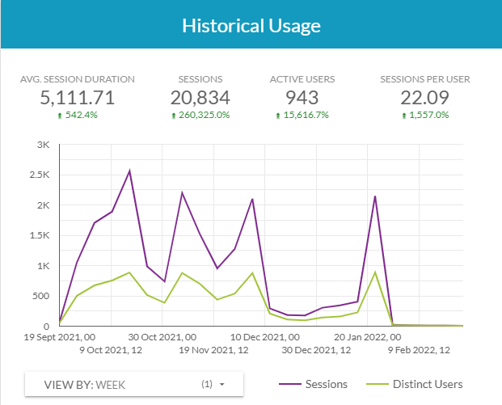
Student Usage – Mobius Overall
2020/21
2021/22

Slide 27
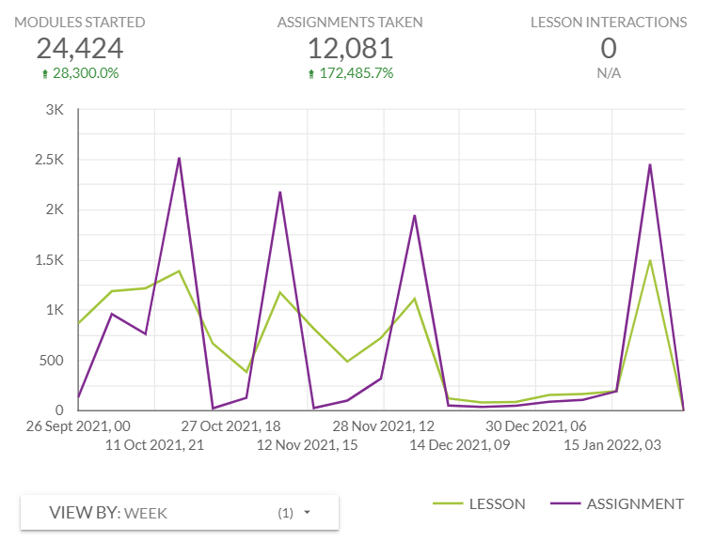
Student Usage – Lessons and Assignments
2020/21
2021/22

Slide 28
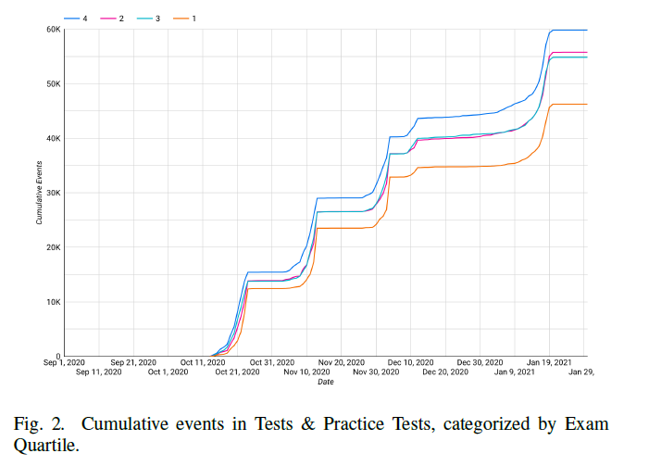
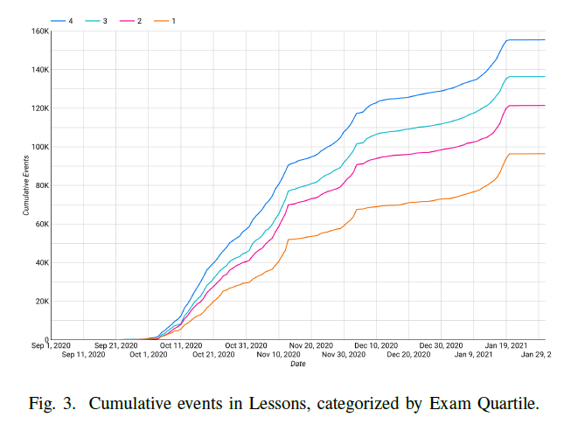
Learning success?
Source: Smith et al. (2022) Student Success in Asynchronous STEM Education:
measuring and identifying contributors to learner outcomes

Slide 29
What did students think?
Number of students providing written comments
Student population app 950 in each year
 | 2020/21 (online) | 2021/22 (hybrid)
Unit Surveys | 75 | 91*
Specific Survey on the use of Mobius Lessons | 63 | 83
Unit Survey Results
 | 2020/21 (online) | 2021/22 (hybrid)
Responses | 336 | 249
Overall, I would rate this unit as being excellent | 4.41 | 4.29
The feedback that I received on my work was helpful. | 4.32 | 4.19
This unit was well organised. | 4.54 | 4.46
* No useful open text question

Slide 30
What did students think? – Specific Survey on the Use of Mobius

Slide 31
What did students think? – Unit Survey Comments – What works – What could be improved
2020/21
Mobius / Lessons
Lessons use | Quality of Material | Videos | Questions | any Mobius |  | Clear Weekly Guidance | Discussion Board | Live Q&A Sessions | Drop in Sessions | Exercise Sheets | Assess-ments
39 | 8 | 15 | 11 | 59 |  | 8 | 14 | 33 | 10 | 3 | 15
 | Mobius / Lessons
Tutorials | Complicated, Too much text | more video | more exercise/interactive | Live instead | any Mobius |  | more student interaction in Live Q&A | structure | Feedback | Workload
9 | 13 | 9 | 5 | 13 | 38 |  | 2 | 2 | 5 | 2

Slide 32
What did students think? – Mobius Survey Comments – What did you like best
Proportions of comments related to …
 | Progress Tracker | Combination of Material | Quality of Material | Work-Outs | Accessability / Flexibility | Interactive / Check Understanding
2021 | 3% | 18% | 32% | 5% | 18% | 23%
2022 | 3% | 14% | 17% | 8% | 36% | 23%
It gave me much more flexibility, and I could work through the material at my own pace. The videos and questions were useful for consolidating and practicing the material.
I had them accessible everytime and I could assess myself on the fresh material.
Having activities in each lesson with the feedback because it allowed me to better understand how to do those kinds of excercises.

Slide 33
What did students think? – Mobius Survey Comments – What could be improved
Proportions of comments related to … (some small categories omitted)
 | More question | More feedback | Too long lessons | Lesson Quality | More videos | More worked examples | Face to Face | Nothing / Use it more
2021 | 23% | 4% | 9% | 9% | 16% | 11% | 4% | 23%
2022 | 12% | 4% | 14% | 19% | 8% | 13% | 13% | 11%
More videos. For me, just reading the maths was not sufficient to actually gain an understanding.
Sometimes very wordy - I understand that it is needed to an extent however sometimes I felt overwhelmed
Less writing and shorter videos as there was too much detail
Making more courses use this method
They are perfect!

Slide 34
How do students think that content should be delivered?
In the questions below, please indicate how you think content for your unit should be delivered? In other words, where would you prefer to see new content for the first time?
The four options are: Reading, Pre-lecture videos, Lectures and Interactive Lessons (like the Mobius lessons).
ENSURE THAT THE FOUR ANSWERS ON THIS PAGE SUM TO 10.
E.g. Readings 3, Videos 6, Lectures 1, Interactive Lessons 0.

Slide 36
What do students think should happen in live meetings?
In the questions below, please indicate how you think the time in live (large group) meetings should be spend?
The options you have here are: Content delivery, Lecturer working through examples/review material, Lecturer responding to student questions, students working on problems
Please ensure that your answers on this page sum to 10.
E.g. Content 7, Examples/Review 2, Questions 1, Student Work 0.

Slide 38
Your role
You are still a teacher, but students may not see that
Your role during term becomes more that of a coach and troubleshooter, rather than a teacher.
Will you be given the time to invest into designing such material?
There needs to be in person teaching for this module. Maths is too technical to be self-taught, which is what many students felt like they were doing

Slide 39
Conclusions
Interactive online textbooks …
are a possible content delivery mechanism
deliver useful learning support for students
can create free lecture time that can be used in great ways
BUT
The greatest challenge is that of convincing students of working in a different way

Slide 40
References
Noun logos (CCBY licence) used by: Alone Forever, Aybige, ferdizzimo
Keramida, M (2015), The Pedagogy Behind MOOCs: What eLearning Professionals Should Know, accessed 25/10/2022
Source: Smith et al. (2022) Student Success in Asynchronous STEM Education: measuring and identifying contributors to learner outcomes

Slide 41
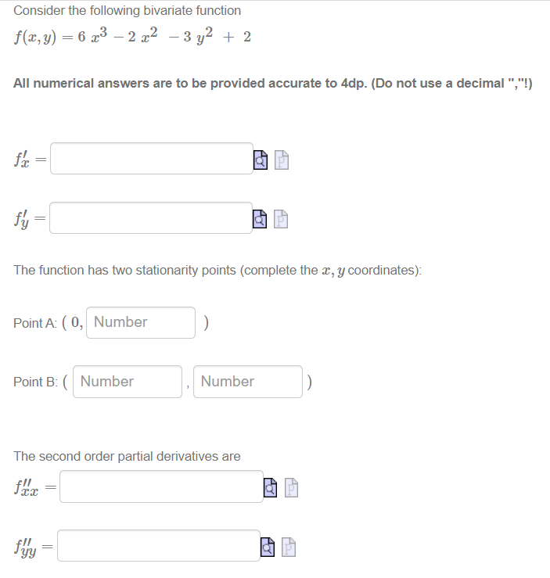
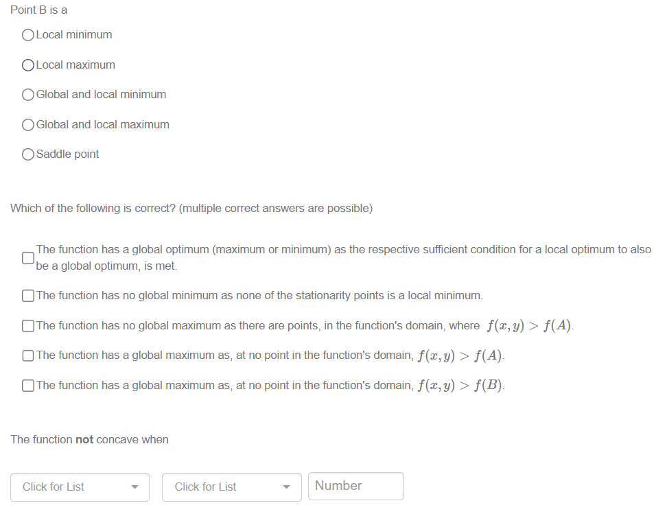
The power of the test engine long questions
Original randomised information

Slide 42
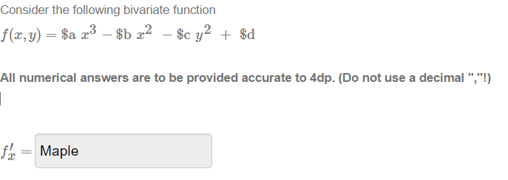
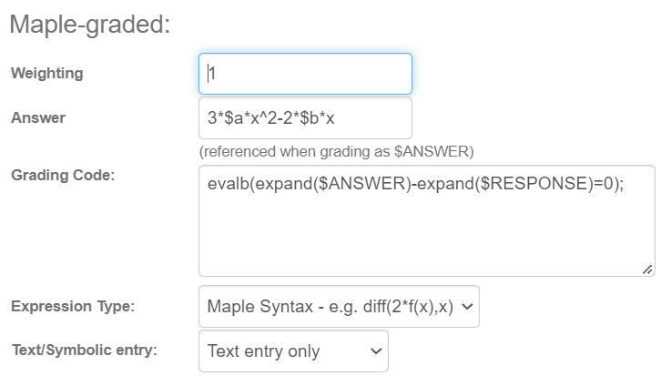
The power of the test engine algebraic answers
Editor view
Student view
Algorithm

